Slide 1
Medical Text Classification using LLMs
Presented by:
Medha Maisa
Course: CSC 590 - Master's Project
Date: 22nd April 2025

Slide 2
Project Objectives
✅ Perform data labeling and preprocessing on two datasets: TCGA and IMR
✅Build a traditional baseline classifier using ML techniques like Logistic Regression.
🔄 Develop and evaluate LLM-based classification models (BERT, BioBERT, GPT).
🔄 Experiment with few-shot learning approaches using LLMs.
🔄 Perform comparative evaluation of models based on performance metrics.
🔄 Visualize findings through confusion matrices, performance charts, and error analysis.

Slide 3
Datasets Used
TCGA Pathology Reports
Independent Medical Reviews Dataset
Real-world clinical data from cancer studies.
Contains complex medical language, negations, and varying report lengths.
Challenges: Contextual labeling, negation handling.
Collection of medical case summaries and decisions.
Initially unlabeled.
Challenges: Identifying mislabels, exploring multi-class classification opportunities.

Slide 4
Data Preprocessing:
Steps Taken:
  Removed duplicates and very short texts.
  Converted text to lowercase and removed special characters.
  Tokenization and normalization applied.
Labeling Strategies:
  TCGA: Created binary labels based on keywords like “cancer”; plan to refine using context and negation detection.
  IMR: Manually reviewed subsets; future work includes verifying and correcting labels.

Slide 5
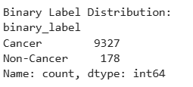
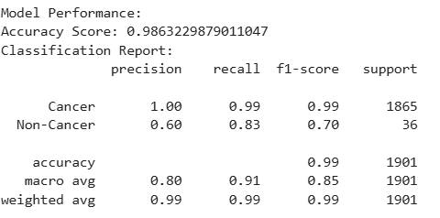
Baseline Model – Logistic Regression
Model Setup:
  Vectorization using TF-IDF
  Binary classification (Cancer vs. Non-Cancer)
Results (so far):
  Accuracy: 98.63%
  F1-Score: 0.99 (Cancer), 0.70 (Non-Cancer)
Insights:
  Model performs well on the majority class.
  Imbalanced data leads to reduced performance on “Cancer” class.
  Labeling strategy and class balance are critical for improvement.

Slide 6
Remaining Work Overview
Dataset Refinement & Labeling
  Handle negations and contextual labeling (TCGA)
  Validate and correct mislabels (IMR)
Rebuild Baseline Model
  Explore Logistic Regression, Random Forest and other methods.
  Select best baseline for comparison
Build LLM-Based Classifier
  Experiment with BERT, BioBERT, GPT
  Fine-tune vs. prompt-based classification
Few-Shot Learning
  Use LLMs with minimal training examples
  Compare against fully fine-tuned models
Analysis & Visualization
  Create charts, confusion matrices, performance tables to visualize differences and results
  Understand and handle misclassifications

Slide 7

Thank you!

